Slide 1



Slide 2
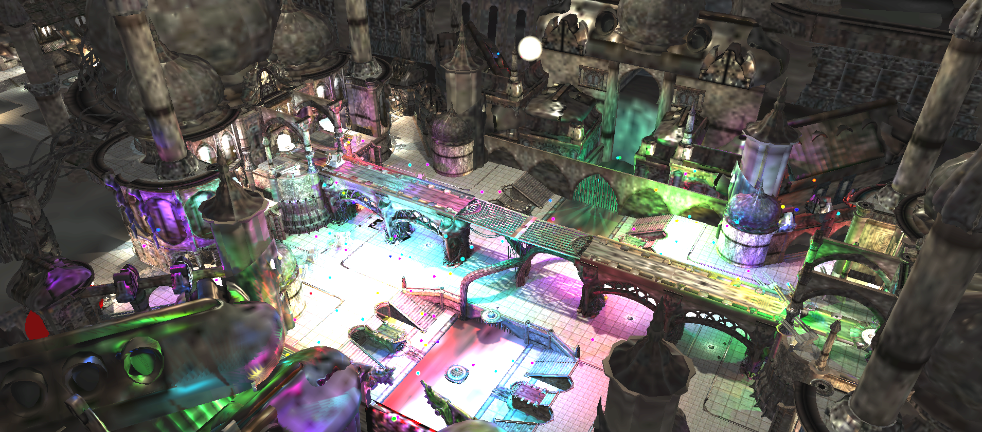
Practical Clustered Shading Ola Olsson – Chalmers University of Technology
Emil Persson – Avalanche Studios

Slide 3
Overview
Part 1
Introduction to Clustered Shading
Ola Olsson – Chalmers University of Technology
Part 2
Practical Implementation at Avalanche
Emil Persson – Avalanche Studios
Notes:
This is the first part of the two part presentation about practical clustered shading. The first part is presented by Ola Olsson, PhD student at Chalmers University of Technology, and covers the motivation, introduction and background to clustered shading. The second part, by Emil Persson, head of research at Avalanche Studios, deals with the reasons and adaptions to put the technique into production in the open-world engine at Avalanche.

Slide 4
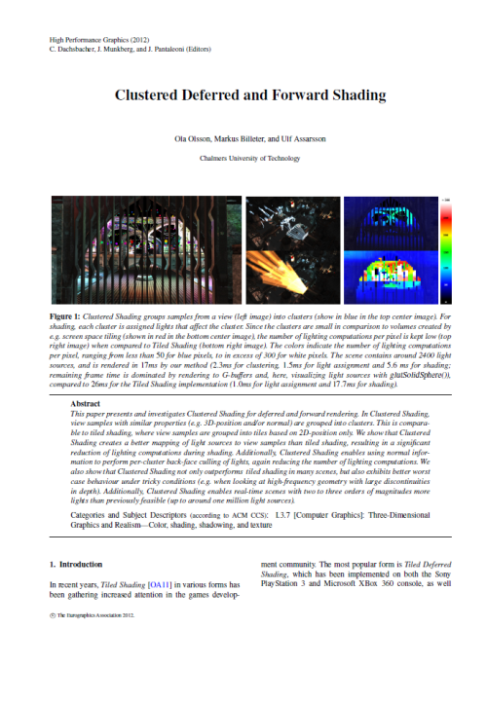
Clustered Shading
“Clustered Deferred and Forward Shading”
Olsson, Billeter, Assarsson
HPG 2012
Extends Tiled Shading
Notes:
Clustered Shading, was first introduced by myself and co-authors in a paper published at the Hight Performance Graphics conference 2012. The algorithm builds on, and extends, tiled shading.

Slide 5
Clustered Shading – Summary
Real-time shading
Thousands of lights
Limited range lights
No shadows
Fully dynamic
Lights and Geometry
Robust performance
Low overhead
Low view-dependence
Handles noisy depth distributions
Even transparency
Can scale to 1M lights.
Influence = 0
Falloff
Light Range
Influence = 1
Notes:
Our algorithm targets thousands of lights in real time,
The lights have a limited range, with some falloff which goes to 0 at the boundary.
This means that lights are not physical, and the scaling with increasing light range is an interesting direction of future work.
We further do not consider shadows, also interesting for future work!
There is no pre-computation, so all geometry and lights are allowed to change freely from frame to frame.
Our evaluation shows that the algorithm
Can be implemented with low overhead
View dependence is low, meaning performance can be robustly predicted from scene complexity.
Can support depth distributions with a lot of noise, i.e. many discontinuities, and also transparency where several depth layers are present.
We show that clustered shading can scale to at least 1M lights, showing the number of lights is not a fundamental limitation
More important at this point is what to do with all these lights!

Slide 6
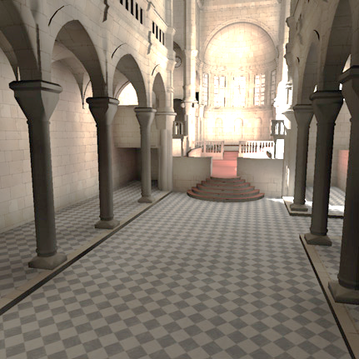
Why More Lights?
Global Illumination
Virtual Point Lights
Photon Splatting
Complex Lights
Area / Volume
Photon Splatting, 739k photons [2]
Notes:
To answer this question I’ve selected a few examples
The first is that it could be used to visualize the result of global illumination simulations
Many lights can be used for virtual point lights, but also photon splatting can use a very similar implementation.
We can also use more lights to emulate complex light types

Slide 7
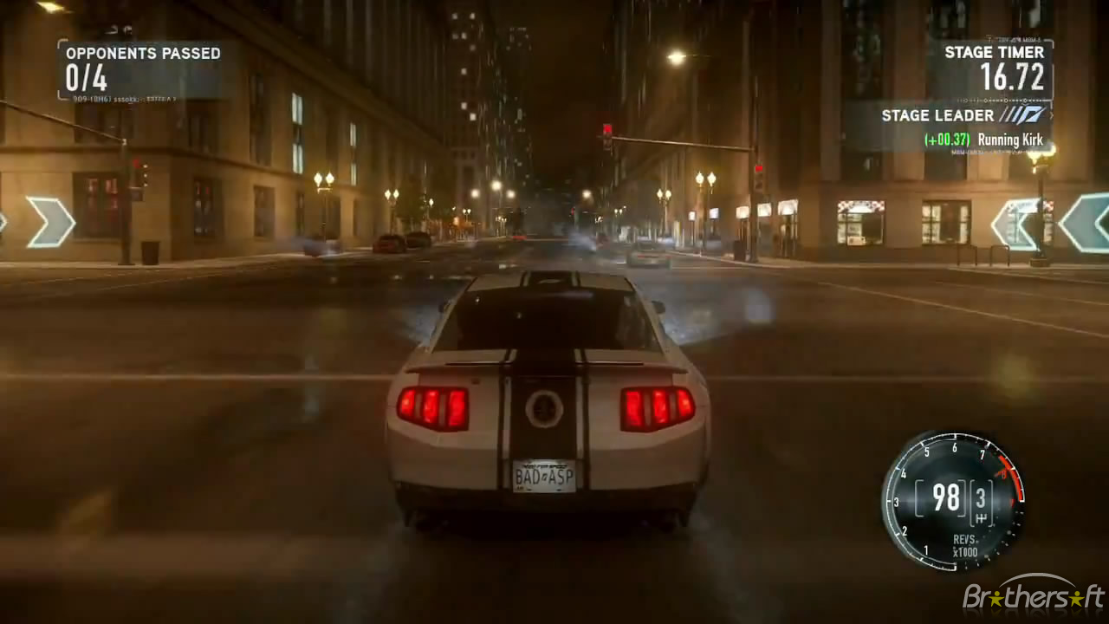
Why More Lights?
Artistic Freedom
Lighting design.
Need For Speed: The Run, ~2600 lights [1]
Notes:
We can also let the artists design the light environment with greater freedom,
As in this example from need for speed the run, which uses many lights to get a GI look

Slide 8
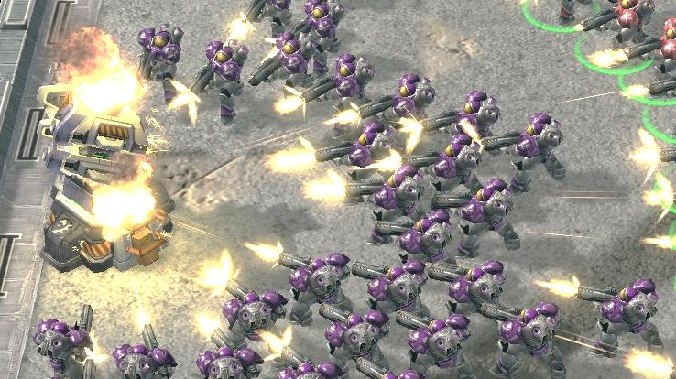
Why More Lights?
Dynamic Effects
Explosions
Particle Effects
Laser
Torches
Etc.
+25
lights
Starcraft 2 [Blizzard 2010]
Notes:
Finally there are many things in games that ought to light up the environment, but doesn’t always
In this example only the big thingo here is a light
All the muzzle flashes are just billboards,
Turning them into lights would add another 25 lights to this scene.

Slide 9
Many Lights – Light Assignment
Lights vs. visible geometry
Hundreds to thousands of lights
Lots of complex geometry
Notes:
The key problem we are trying to address in our paper and in this talk is how to figure out which lights affect what geometry.
This becomes difficult when we are dealing with thousands of lights and lots of complex geometry.
So, while the technique is called “clustered shading” for historical and contextual reasons going back to deferred shading and tiled shading, a more precise name might have been ‘Clustered Light Assignment’. We will however persist in calling it clustered shading for consistency with published work.

Slide 10
Many Lights – Light Assignment
Previous Solutions
Traditional – per object
Deferred Shading – per pixel
Modern Solutions
Tiled Shading – per pixel tile
Clustered Shading – per 3D tile
Notes:
Older solutions have solved this either on a per object basis, which has a lot of inherent problems, such as the conflict between optimizing batch size for drawing and minimizing light influences (consider a long and skinny bit of geometry with few polygons.
or per pixel, as in deferred shading, which typically is a bandwidth limited process on modern hardware.
Modern solutions attain higher performance by working on groups of pixels.

Slide 11
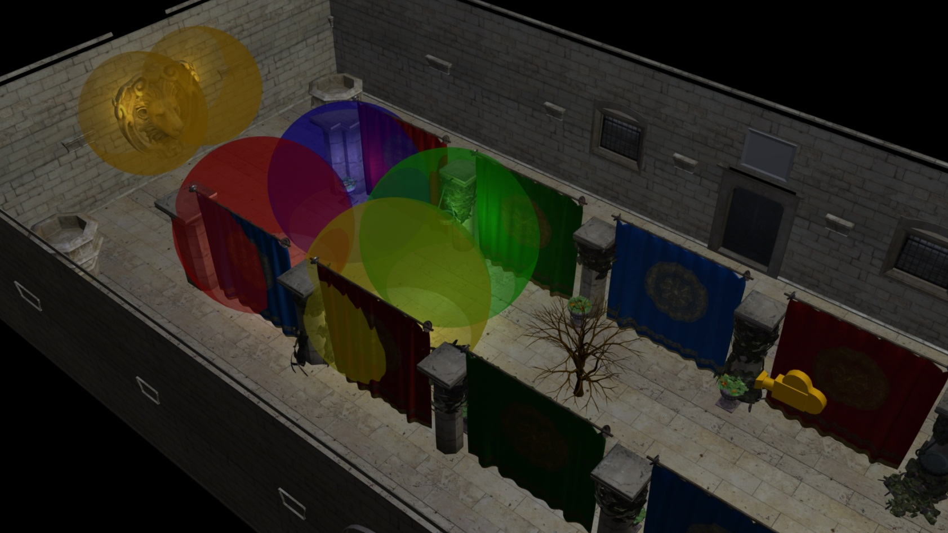
Example Scene
Crytek Sponza
Minus top
6 Lights
A Tree
Notes:
We will be using this example scene to illustrate how tiled and clustered shading works.
The scene is the usual Crytek Sponza scene, but with the top three quarters lifted off, to let us get a better view.
I’ve added six lights of different colours, represented as spheres.
To make the view more interesting, I’ve also added a tree.

Slide 12
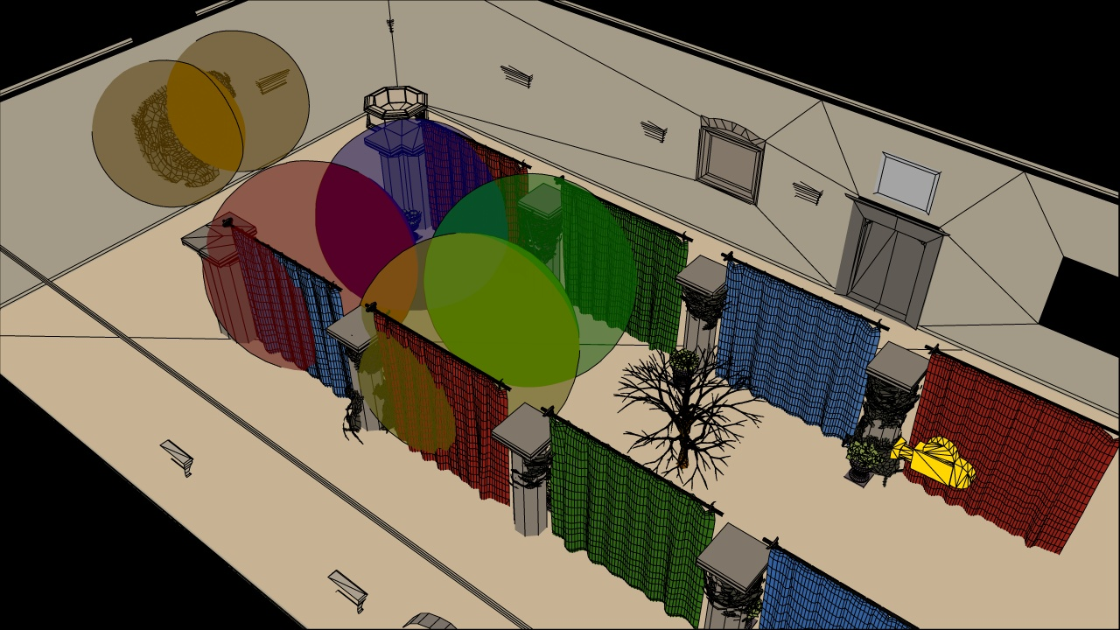
Example Scene
Crytek Sponza
Minus top
6 Lights
A Tree
Notes:
The same view in outline mode, to make it more clear.

Slide 13
Example Scene
Crytek Sponza
Minus top
6 Lights
A Tree
Notes:
This is the viewpoint that will be used to demonstrate the algorithms, the camera is looking through the tree towards the lion head on the wall.

Slide 14

Example Scene
Notes:
Shifting to the point of view of the yellow camera.

Slide 15
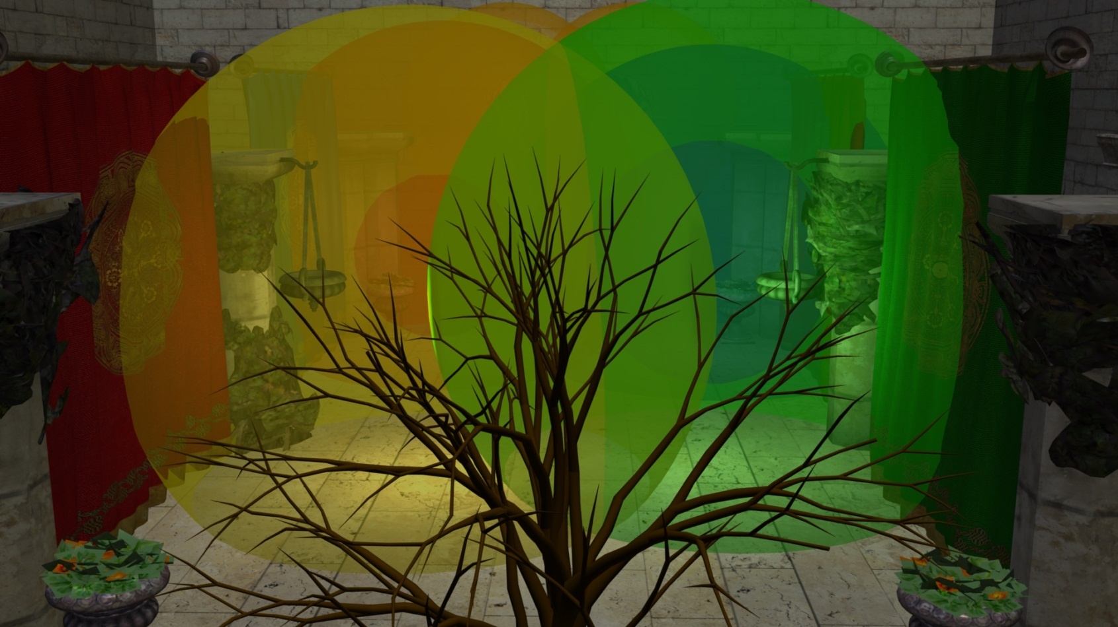
Tiled Shading Recap
Deferred or Forward*.
Simple.
Fast (sometimes).
2D
* Which AMD calls “Forward+”
Notes:
Now I will go into a re-cap of how tiled shading works.
Tiled shading can be implemented using either deferred of forward shading techniques, or a mix. Note that AMD insists on calling “Tiled Forward Shading”, “Forward+”, it is however identical.
For light assignment, it matters very little which form we use, so I will not go into specifics.
It is conceptually very simple, and also relatively easy to implement, at least in the simplest form.
Performance is good, given the right circumstances.
And fundamentally it is a 2D algorithm.

Slide 16
Tiled Shading Recap
Screen space tiles
E.g. 32x32 pixels
Each contains list of lights
Notes:
Tiled Shading works like this.
The screen is divided into tiles, each covering say 32 by 32 pixels.
Each tile contains a single list of all the lights that might influence any of the pixels inside.
Note that this list is shared between the pixels, so overhead for list maintenance and fetching is low.

Slide 17
Tiled Shading Recap
For each Light
Find screen space AABB
Notes:
To construct the lists, we might do as follows.
For each light, establish the screen space bounding box, illustrated for the green light.

Slide 18
Tiled Shading Recap
For each Light
Find screen space AABB
Add light to affected tiles
1
1
1
1
1
1
1
1
1
1
1
1
1
1
1
1
1
1
1
1
1
1
1
1
1
1
1
1
1
1
1
1
1
1
1
1
1
1
1
1
1
1
1
1
1
1
1
1
1
Notes:
Then add the index of the light to all of the overlapped tiles.

Slide 19
Tiled Shading Recap
1
1
1
1
1
1
1
1
1
1
1
1
1
1
1
1
1
1
1
1
1
1
1
1
1
1
1
1
1
1
1
1
1
1
1
1
1
1
1
1
1
1
1
1
1
1
1
1
1
Notes:
Then repeat this process for all remaining lights.

Slide 20
Tiled Shading Recap
1
1
1
1
2
2
2
2
1
1
1
1
1
1
1
2
2
2
2
1
1
1
1
1
1
1
2
2
2
2
1
1
1
1
1
1
1
2
2
2
2
1
1
1
1
1
1
1
2
2
2
2
1
1
1
1
1
1
1
2
2
2
2
1
1
1
1
1
1
1
2
2
2
2
1
1
1
1
1
1
1
1
1
1
1
Notes:
The illustration only shows the counts, so you need to imagine the lists being built as well.
In practice we’d also do a conservative per-tile min/max depth test, to cull away lights occupying empty space.

Slide 21
Tiled Shading Recap
Shading pass
Deferred or Forward
For each sample
Loop over list of lights
Notes:
Once all the lists are constructed, a shading pass is performed.
For tiled deferred shading, it is a deferred full screen pass.
For tiled forward shading, it is a geometry pass.
In each case the light list is looked up using the fragment coordinates and looped through and shading is accumulated.

Slide 22
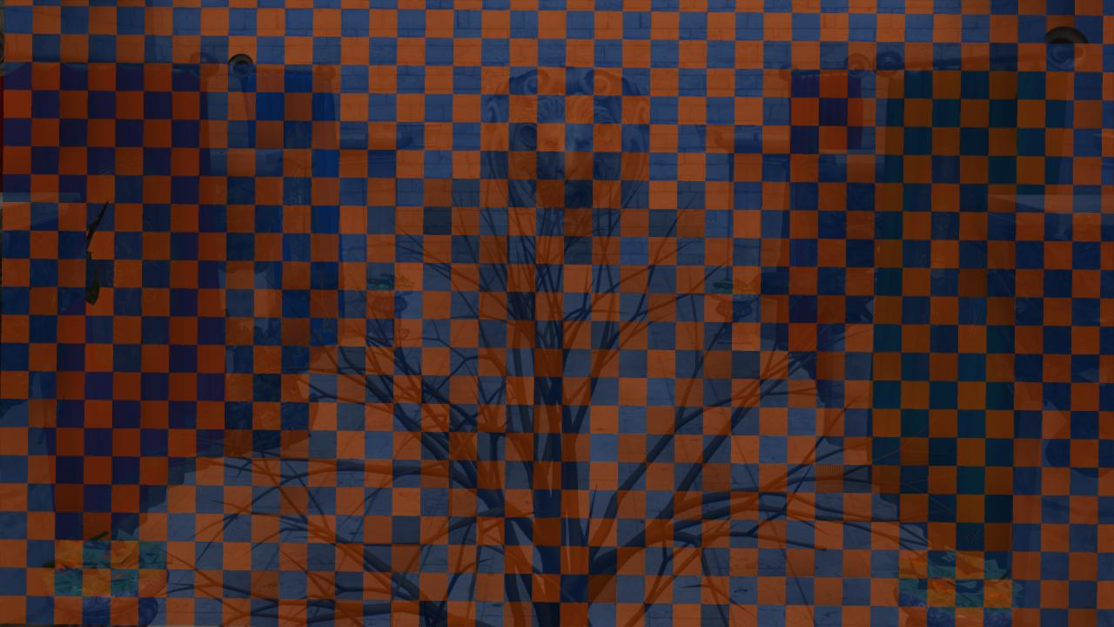
Tiled Shading
Notes:
This is a view of the tile geometry pulled out of our implementation.

Slide 23
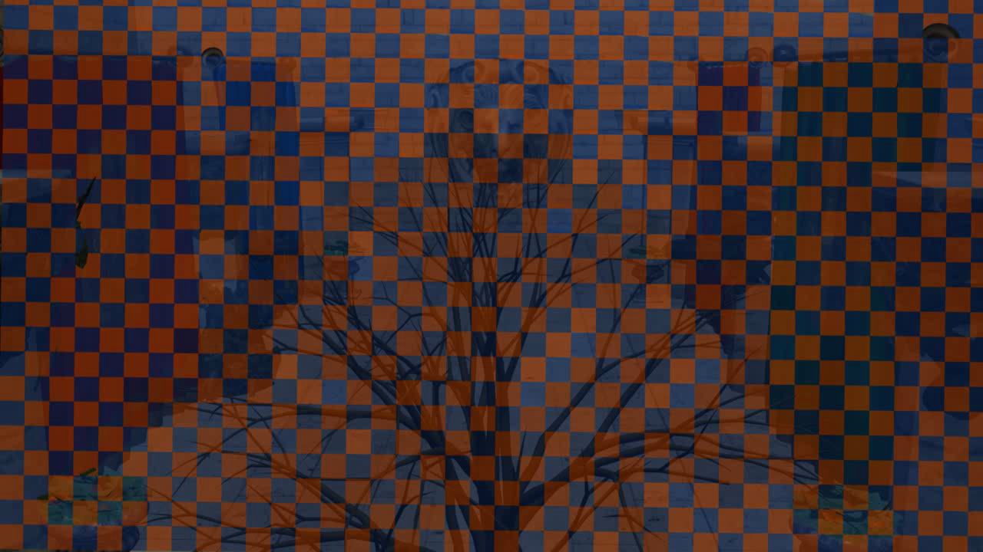
Tiled Shading
Notes:
Switching to the overhead view, we see how they extend from the tree over to the background geometry.

Slide 24
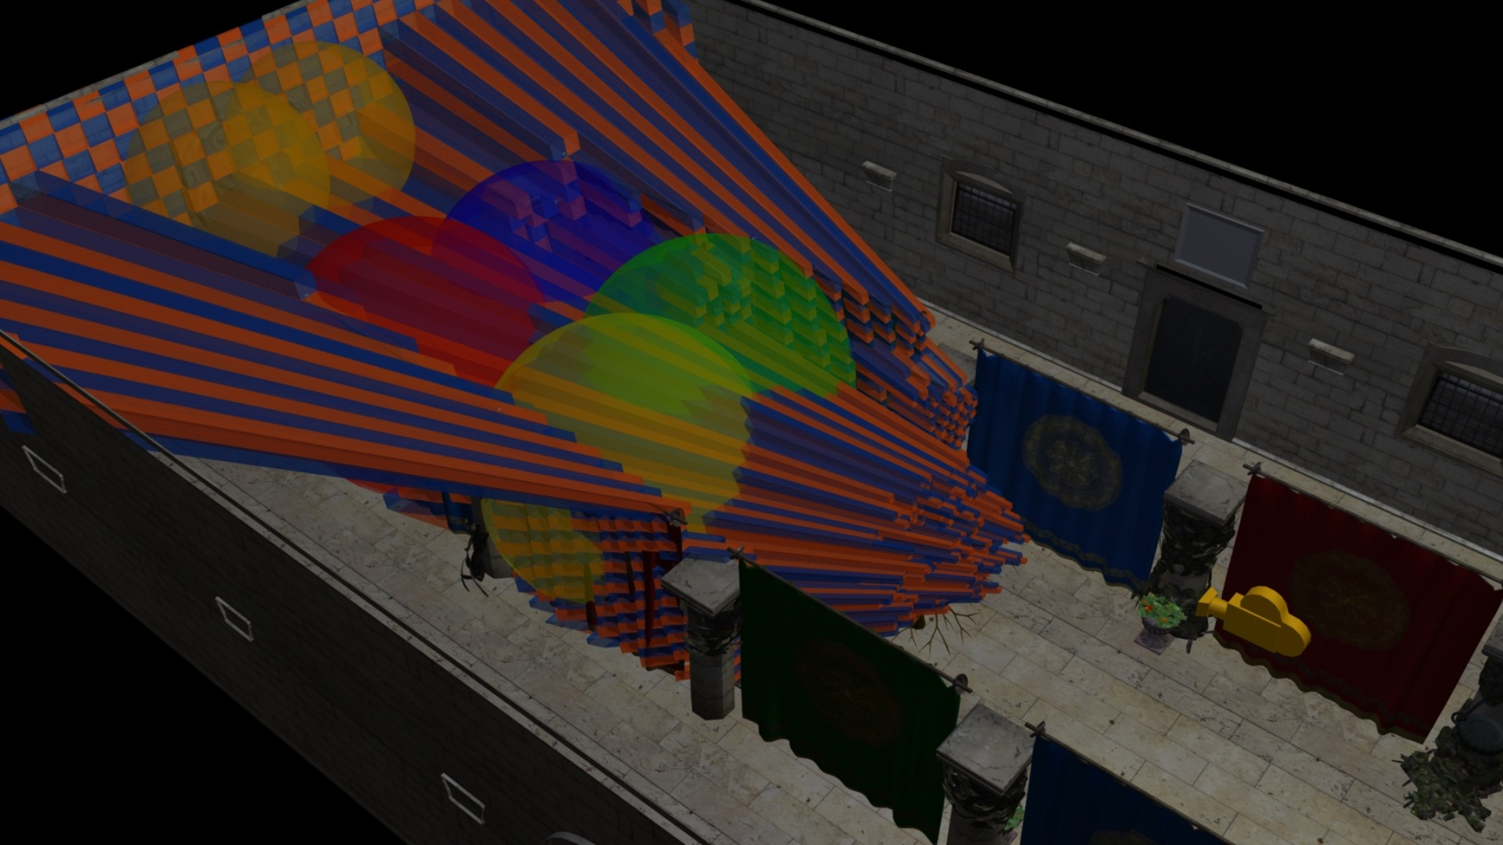
Tiled Problems
Tiles – 2D
Games – 3D
Hmm…
Notes:
Toggling on the light geometry, we see that there is a lot of overlap…
…even in the empty space behind the tree.
We now should be able to start seeing the shape of the problem with 2D tiles in a 3D world.

Slide 25
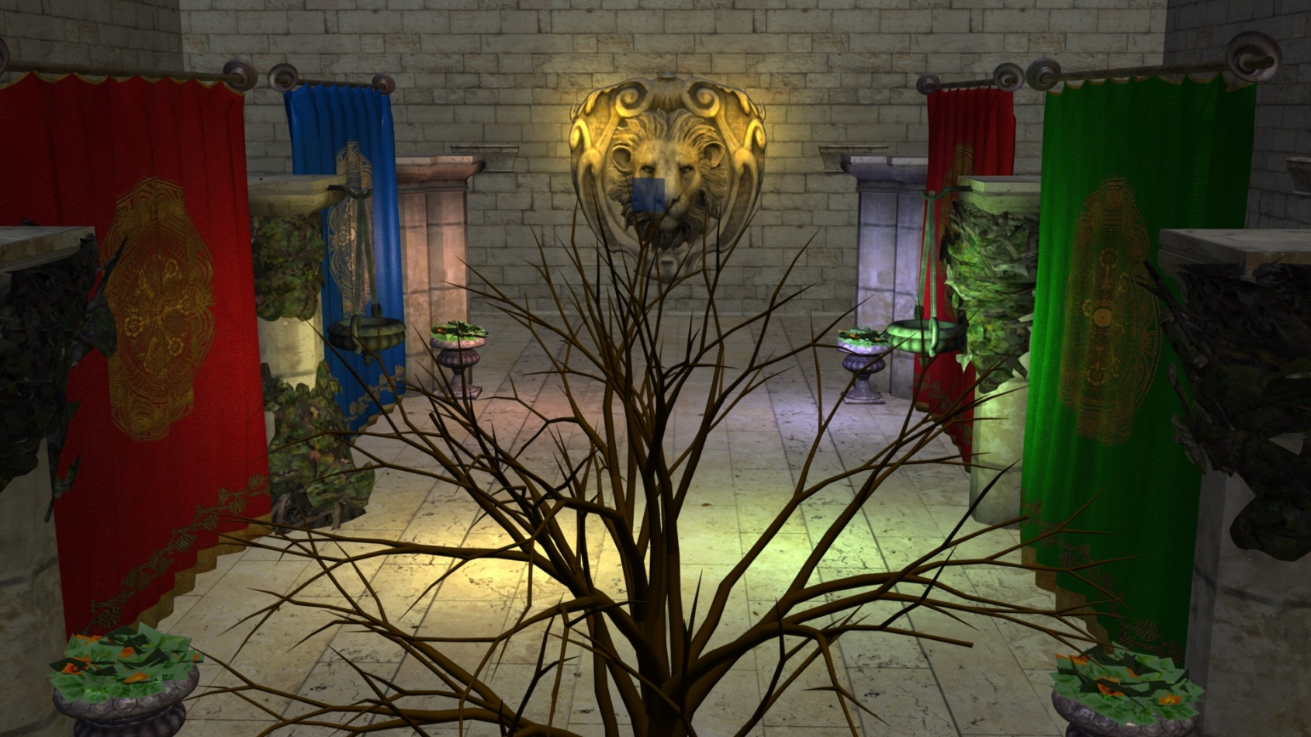
Tiled Problems
Single Tile
Notes:
We’ll now take a closer look at a single tile, in order to highlight the problem.

Slide 26
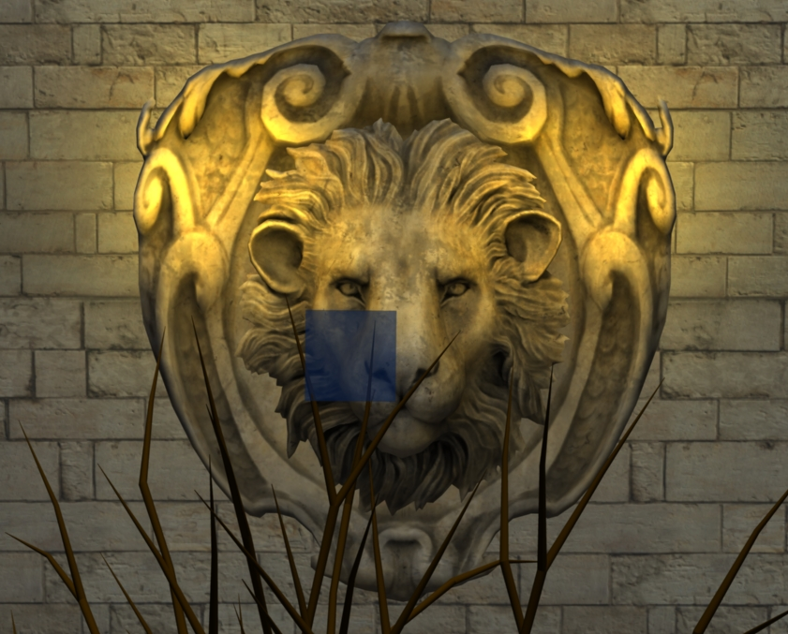

Tiled Problems
Single Tile

Slide 27
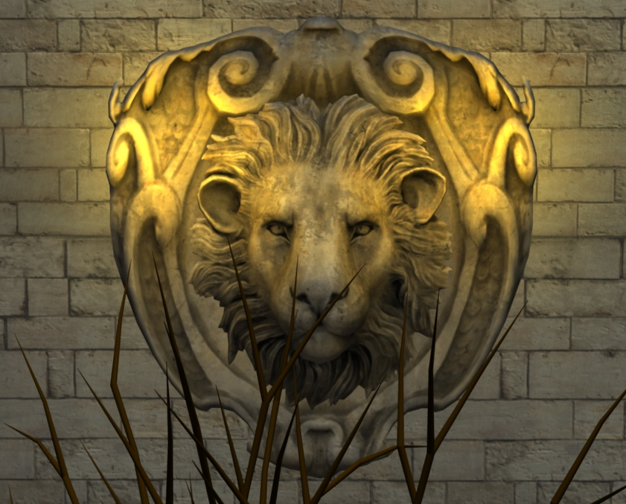
Tiled Problems
Single Tile
Notes:
As we can see, there is a small number of samples from the tree
And the rest, the lion share of the pixels are in the background.

Slide 28

Tiled Problems
Notes:
* In 3D the tile looks like this…

Slide 29
Tiled Problems

Slide 30
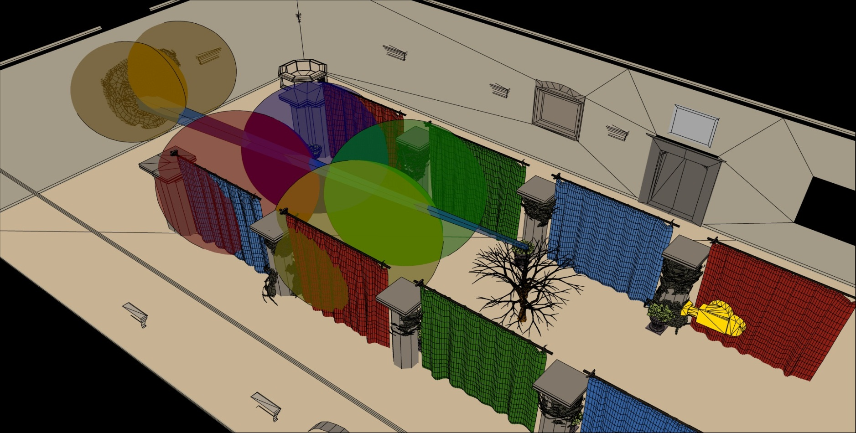
Tiled Problems
Intersects all 6 lights
Notes:
Extending from the tree through the visible scene to the wall.
This one troublesome tile intersects all 6 lights in our simple test scene.

Slide 31
Tiled Problems
Intersects all 6 lights
Notes:
While actually some of the samples, from the tree, are affected zero of these lights.

Slide 32
Tiled Problems
Intersects all 6 lights
Notes:
And the rest, would only need two of the lights.

Slide 33
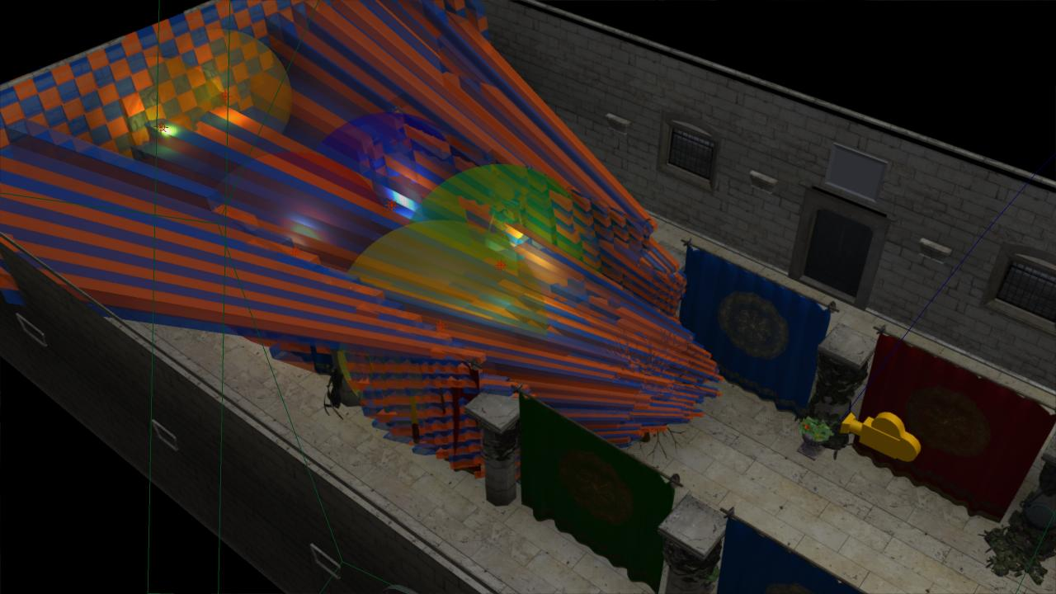
Tiled Problems
Tiles – 2D
Geometry Samples – 3D
Fragments / Pixels
Light density – 3D
View dependent
Unpredictable shading times
Notes:
So as we have shown, there is a fairly fundamental problem with tiled shading.
The basic problem stems from that we are making the intersection between lights and geometry samples, both of which are 3D entities, in a 2D screen space.
The main practical issue with this is that the resulting light assignment is highly view dependent. This means that we cannot author scenes with any strong guarantee on performance, as a given view of the scene may have a significantly higher screen space light density than average.
For example, we’d like to be able to construct a scene with, say, maximum 4 lights affecting any part of the scene. In this case, we would like shading cost to be proportional to this, and stable, given different view points. Unfortunately, no such correlation exists for tiled shading.
In other words shading times are unpredictable, which is a major problem for a real time application.

Slide 34
Clustered Shading - Key Idea
Add the 3rd dimension
Tile also in depth direction = cluster
Also > 3 dimensions (e.g. normals)
far
near_{k}
far_{k}
Y
h_{k}
Z
d_{k}=h_{k}
near
Notes:
So how do we solve this?
This is the basic question for our clustered shading paper.
A fairly obvious solution, given what has been said so far, is to use 3D tiles of some sort.
It is less obvious what particular kind of subdivisions to use, and whether this will actually improve efficiency.
Another question we explore in the paper is to tile in yet higher dimensions, based on normal direction as well.

Slide 35
Clustered Solutions
Notes:
Compare the tiles show here…

Slide 36
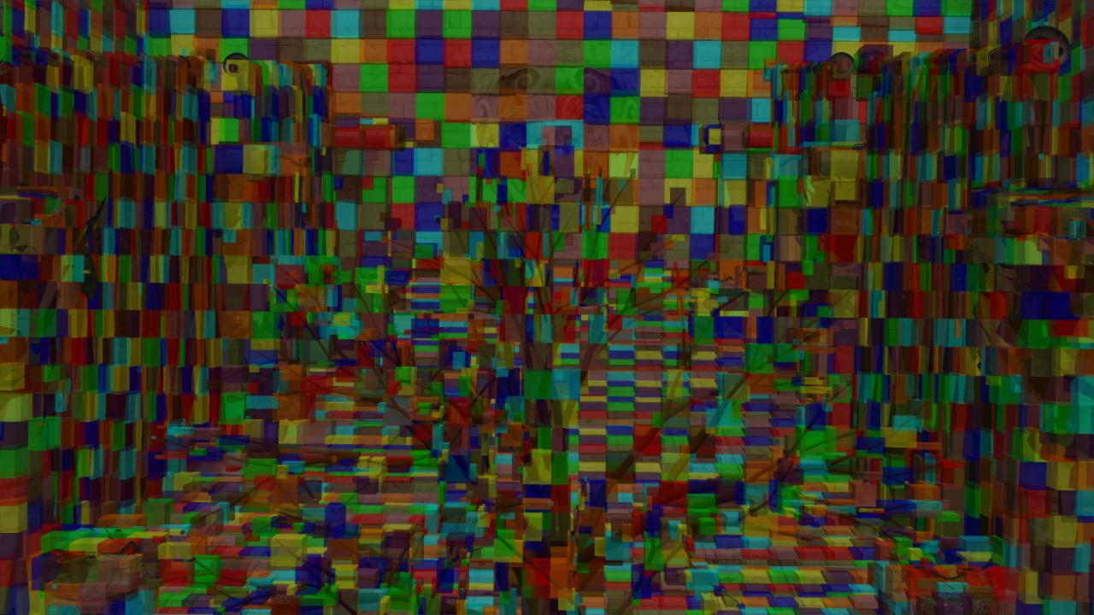
Clustered Solutions
Notes:
…with the view space cluster AABBs shown here.
Along the top edge of the screen, it is easy to see that the clusters and tiles are very similar, where the depth within each tile is shallow.
In the middle, where the tree is, things are more interesting, as several layers of depth are visible.

Slide 37
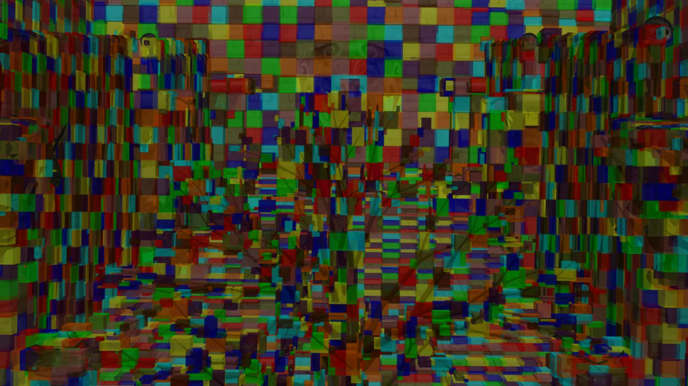
Clustered Solutions
Notes:
Going to the overhead view again.

Slide 38
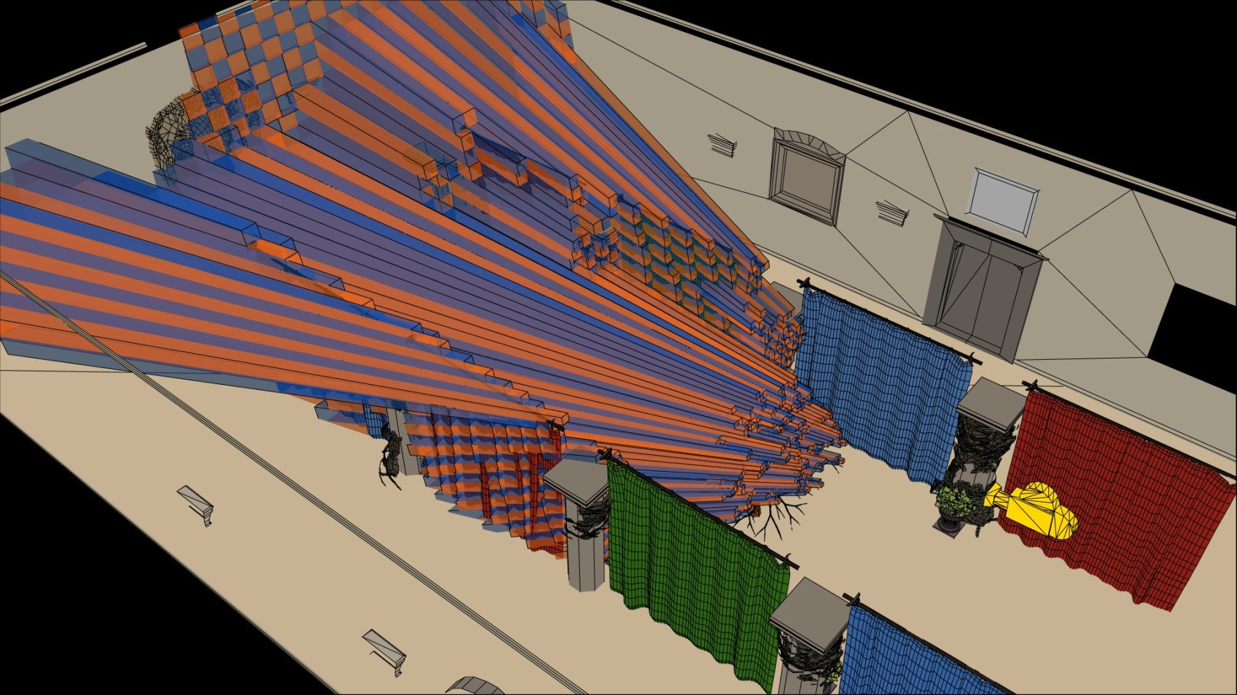
Tiled Problems
Notes:
Comparing the tiles…

Slide 39
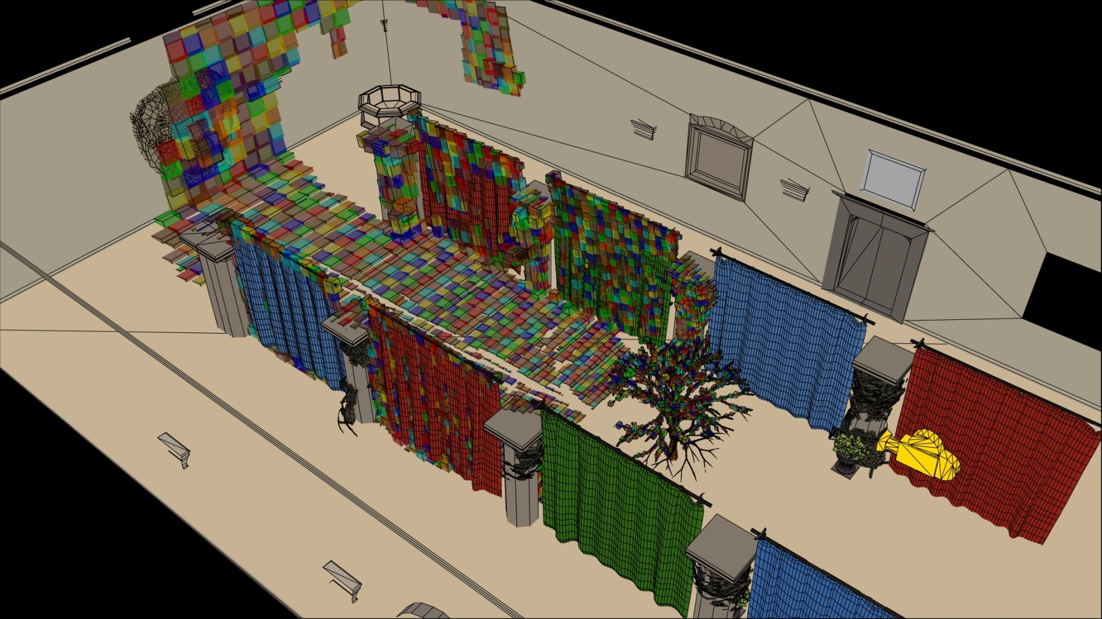
Clustered Solutions
Notes:
…to the clusters, shows that the clusters approximate the visible geometry a lot better.
This means that the intersection with the light volumes ought to also be more precise.

Slide 40
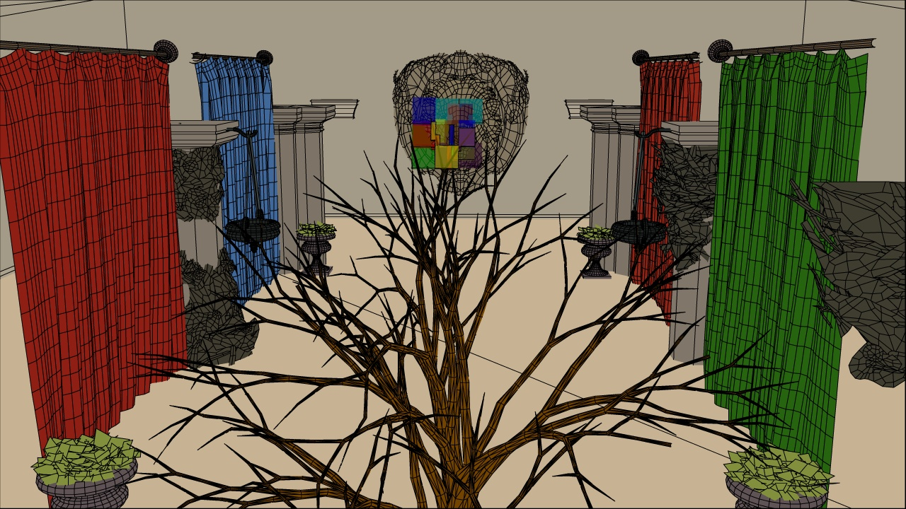
Clustered Solutions
Notes:
Going back to the single tile example, but with clusters.

Slide 41
Clustered Solutions
Notes:
Except that there are several clusters instead of a single tile now.

Slide 42
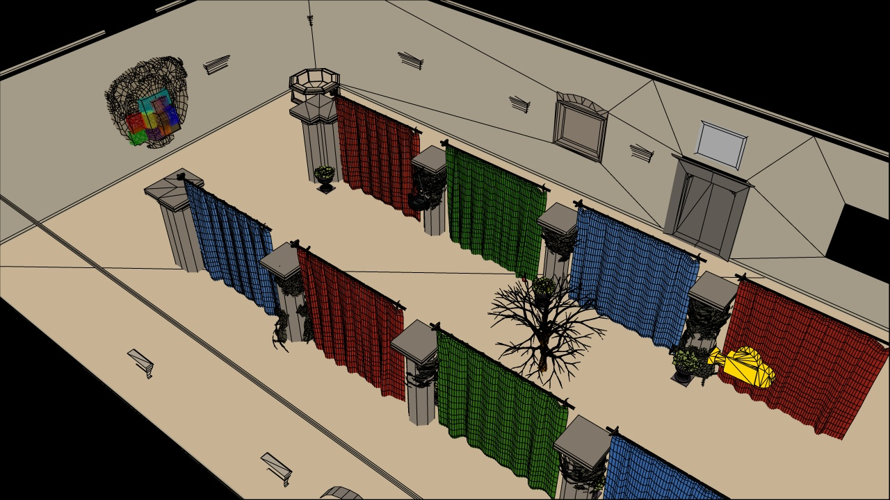
Clustered Solutions
Clusters – 3D
Games – 3D
Yay
Notes:
…

Slide 43


Tiled Problems

Slide 44
Tiled Problems
Intersects no lights
Notes:
We see that none of the lights overlap the clusters that are on the tree in the fore ground.

Slide 45
Tiled Problems
Intersects 2 lights
Notes:
And in the background, only the volumes of the two required lights intersect.
Clearly clusters has a good potential for improving efficiency, we’ll now need to talk about how they can be implemented.

Slide 46
Clustered Shading – Algorithm
Rasterize G-Buffers
Forward: pre-z pass
Cluster assignment
Find unique clusters
Assign lights to clusters
Shade view samples
Deferred: Full screen pass
Forward: Geometry pass
Notes:
This is a high level version of the clustered shading algorithm
I’ve grayed out parts that are identical to tiled shading.
Cluster assignment means to identify what cluster each sample belongs to, this is a simple mapping.
Then we need to work out which of the clusters are represented by these samples, and
Finally we assign lights to these clusters, ensuring we are not wasting storage and work assigning lights to empty clusters.
Note that Emil will be presenting a rather different approach to implementing the algorithm, which leaves out and replaces the first two steps.

Slide 47
Cluster Assignment
near
near_{k}
far_{k}
far
Cluster key:
ck = (i, j, k) integer tuple
i, j = 2D tile id
gl_FragCoord.xy
k = log(view space z)
Y
Eye
h_{k}
Z
d_{k}=h_{k}
Notes:
Cluster assignments is a simple mapping from sample coordinate, to an integer tuple i,j,k
i and j are simply the tile coordinates, which can be derived by dividing gl_FragCoord.xy by the tile size.
k is a logarithmic function of the view space Z of the sample, not simply the logarithm, for the exact equation see the paper.
We use this subdivision as it creates self similar clusters that are as cube like as possible. This makes them better suited for culling. The logarithmic subdivisions also means that as clusters become larger further away, we get a kind of LOD behaviour and do not end up with insane numbers of clusters, for a wide range of view parameters.

Slide 48
Finding Unique Clusters
Full screen pass.
Flag used clusters.
Read depth
Compute ck
Set cell in grid to one.
Forward:
Geometry pass with side effect.
Y
Eye
Z
near
far
Notes:
Finding the unique clusters is a full screen pass, which simply constructs the cluster key for each sample.
And sets the corresponding cell in a 3D grid to 1. This grid is non-regular subdivision of the view volume.

Slide 49
Finding Unique Clusters
Compact Non-Zero
Yields list of non-empty clusters.
Parallel prefix sum
chag::pp (CUDA)
thrust (CUDA)
Compute Shader API?
Y
Eye
Z
near
1
2
4
5
6
7
32
33
34
39
far
Notes:
We then compact the grid into the list of non-zero elements.
This can be implemented through a parallel perfix sum.
Which is a very quick process, for the million elements or so needed.
Taking a fraction of a millisecond.
This leaves us with a list of clusters which needs lights assigned to them.

Slide 50
Light Assignment
Many clusters
Many lights
Hierarchical approach
Hierarchy over lights
32-way tree (matches SIMD of GPU)
Dynamically rebuilt on GPU
Each cluster traverses light tree
BV tests
Notes:
When pushing the limit on number of lights, a hierarchy over lights makes sense.
We use a BVH with a branching factor of 32, which is rebuilt each frame.
When not so many lights are used, there are many other approaches which may be better. Again Emil will show a rather different approach later on.

Slide 51
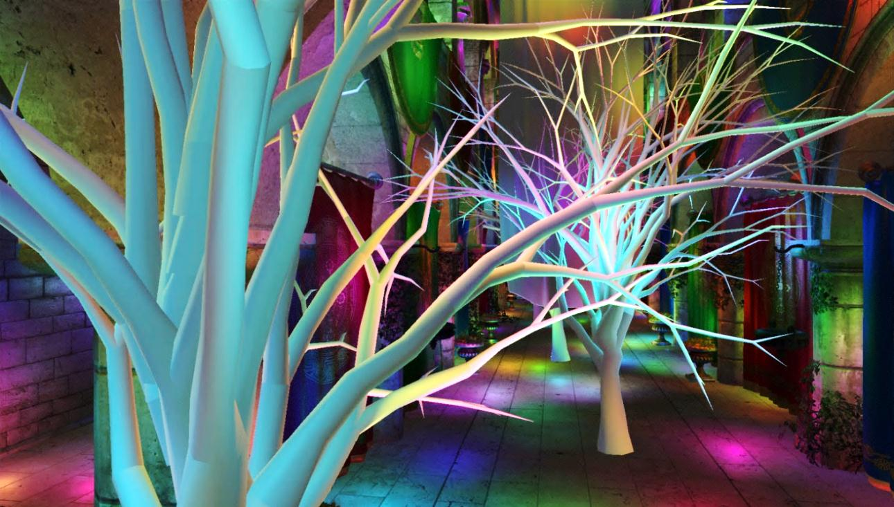
Results
Crytek Sponza
+Trees
10k Lights
Tough on Tiles
Notes:
So for some results.
This is the good old crytek sponza scene again, but this time with 3 trees added, and 10 thousand lights.
This is a pretty difficult scene for tiles, and we use it to highlight where the algorithm breaks down.
It is, however, not a completely outrageous case, with large areas of coherent pixels, and a moderate number of lights if global illumination effects are considered.

Slide 52
Results (GTX 480) Sponza + Trees
Tiled
Deferred
Clustered
Deferred
Clustered
3x3 Normals
Clustered
Forward
Clustered
Explicit
Clustered Explicit
3x3 Normals
Notes:
As seen here, tiled shading is dominated by shading time, even for our quite simple pixel shader.
This means that improving speed of the tiling would ot change the result much.
Clustered shading, on the other hand, is more balanced between shading and other parts of the algorithm.
Also shown are three variants with more complex culling based on normals as well. These do not pay off in our implementation as the reduction of shading cost is overtaken by the cost of more complex culling and a greater number of clusters.
With more expensive shading and better implementation of clustering and culling, they might still be worhtwhile.

Slide 53
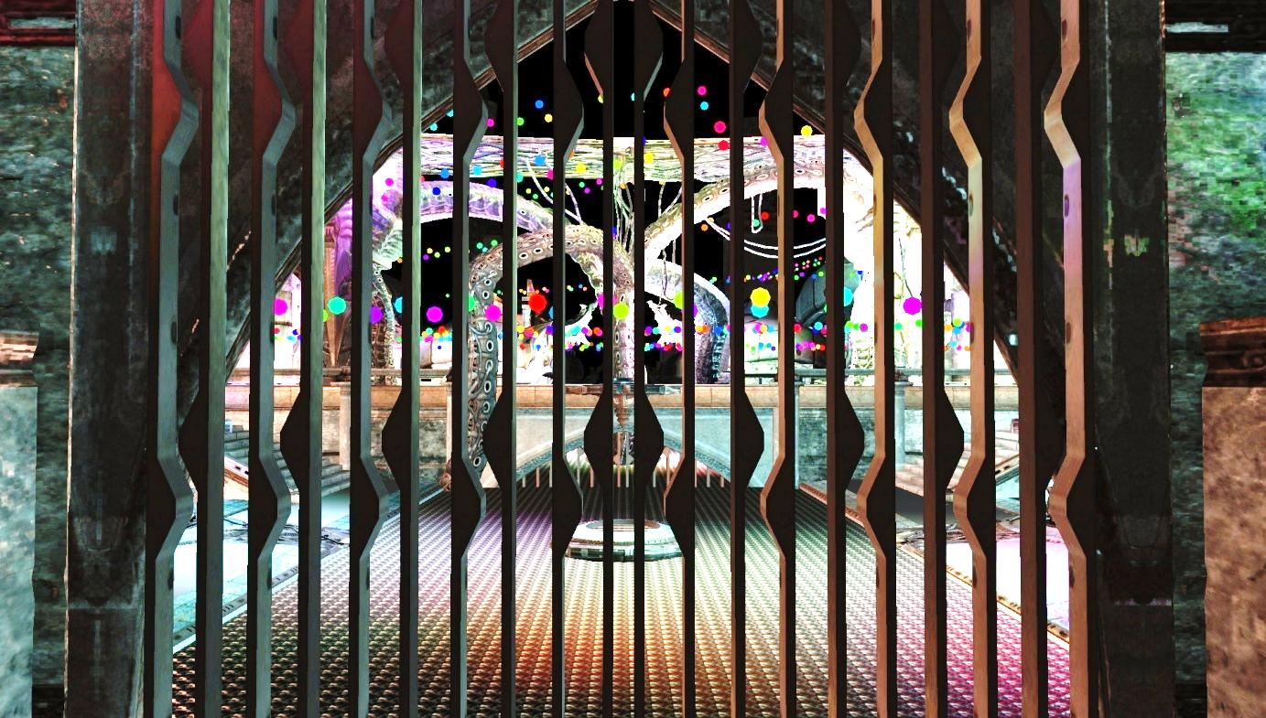
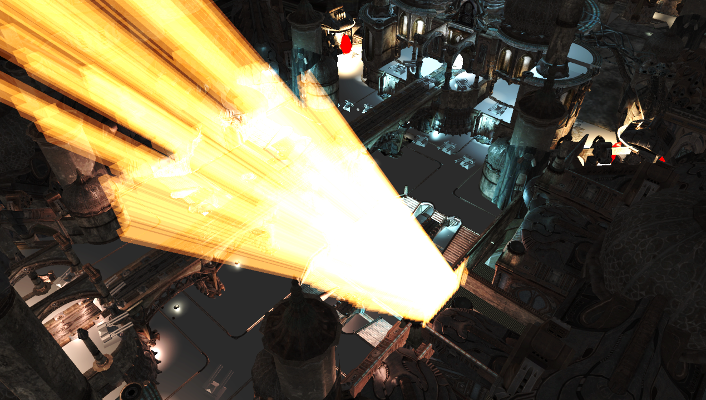
More Results
Discontinuities
- Unreal 3 Scene
‘Necropolis’
- Tricky view
But not artificial
View from Camera
2D tiles with depth bounds
High light density
Around 2000 lights
3D bounds for Tiles
Notes:
This is a view from the scene Necropolis included in the UDK (Unreal SDK).
We have added a few thousand dynamic lights (shown as lovely GLUT solid spheres), to spice things up.
The tile bounds shown to the right, are as horrible as we might expect.

Slide 54
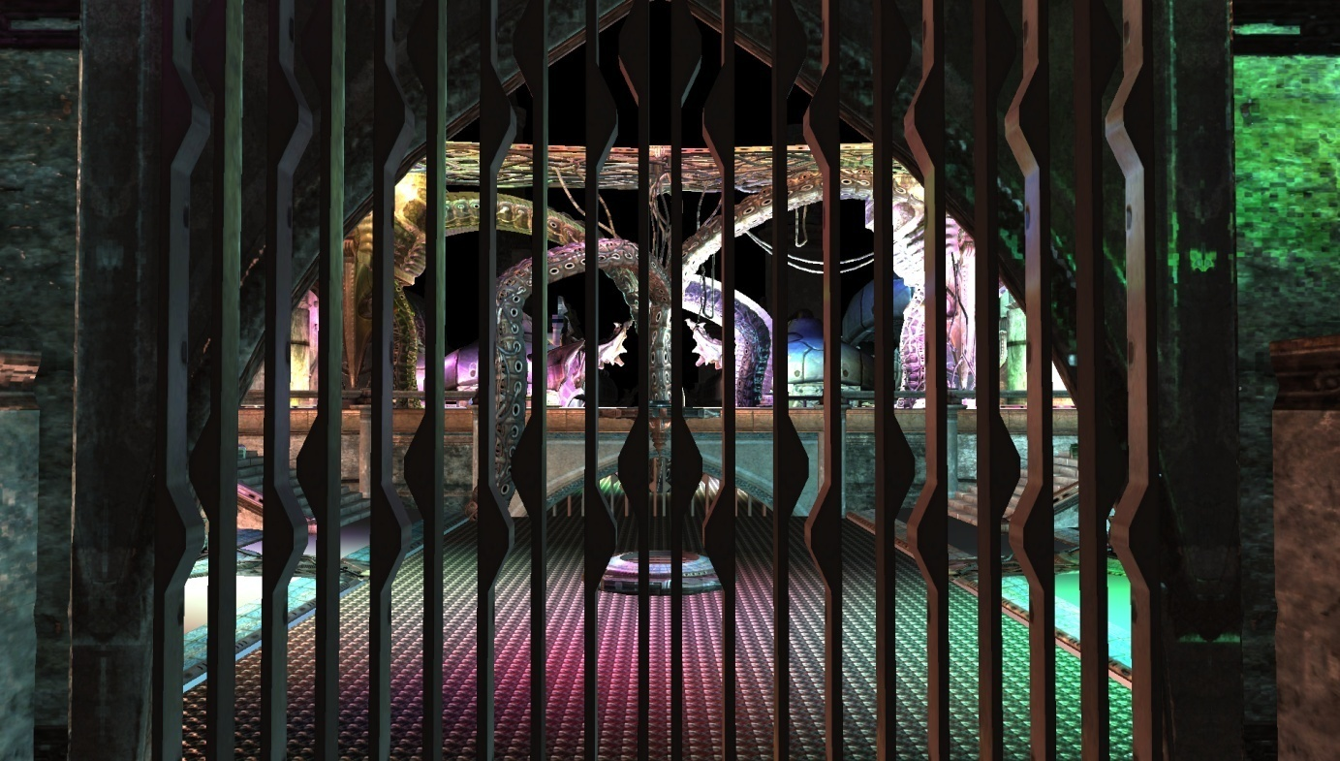
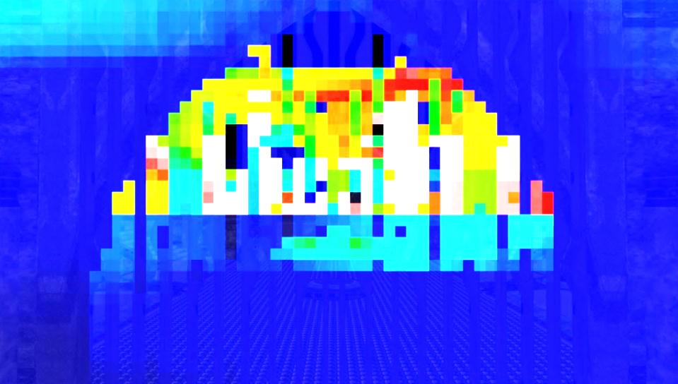
More Results
Discontinuities
Black = zero
Green ~ 150
White > 300
# Lights / Tile
Tiled: 18.8ms
Clustered: 9.4 ms
3D bounds for Tiles
Notes:
And the performance, follows.
In the white parts there are more than 300 lights for each sample.
Tiled Deferred Shading clocks in at 18.8 ms per frame.
Clustered, almost exactly half that time.

Slide 55
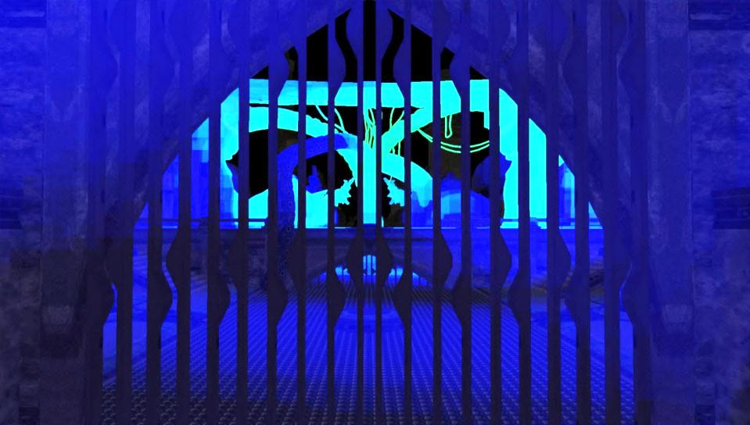
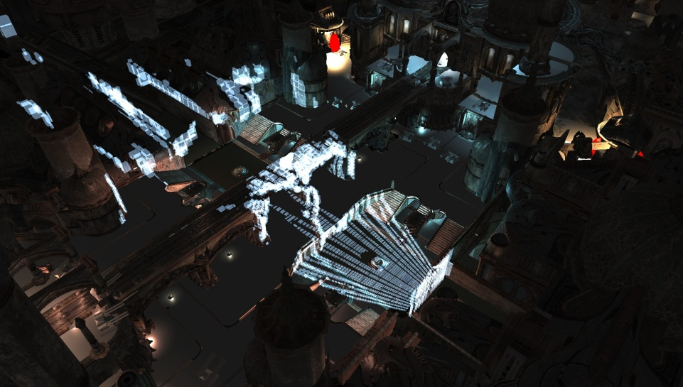
More Results
Discontinuities
Black = zero
Green ~ 150
White > 300
# Lights / Tile
Tiled: 18.8ms
Clustered: 9.4 ms
3D bounds for Clusters
Notes:
Looking at the heat map, clustered shading tops out at around 100 lights per sample, so there is still some pretty dense lighting going on out there.
As we can see to the right, the clusters match the geometry that much better.

Slide 56
Tiled Forward Shading [4]
Transparent Geometry
Problem
View dependent
Degenerates to 2D
Full screen discontinuity!
Y
Eye
Z
near
far
Notes:
Talking briefly on what happens when we add transparent geometry to the mix.
In tiled shading, the result of transparent geometry covering the view is effectively the loss of the depth range optimization
which has been shown to lead to poor performance.
Again, the biggest issue here is that it is view dependent, and so will only be possible to determine at run time
and, as we all know, this kind of problem usually starts showing up five minutes after we shipped a build to the publisher.

Slide 57
Clustered Forward Shading [4]
Pre-geometry pass.
Flag used clusters.
Side effect in fragment shader.
Set cell in grid to one.
Y
Eye
Z
near
far
Notes:
Clustered Shading does not suffer from this problem, as each cluster represents a fixed section of 3D space.
The only problem we face is trying to determine what clusters are need such that we can assign lights to them.
This can be done by rendering a pre-pass with the transparent geometry.
This can be performed after a regular G-buffer or pre-z pass, with color and depth writes turned off, and sets the used clusters to one as a side effect in the fragment shader.
The algorithm is otherwise as before.
Note that clustered shading provides an efficient way to solve the light assignment problem for any transparency technique, not just good old order dependent transparency.

Slide 58
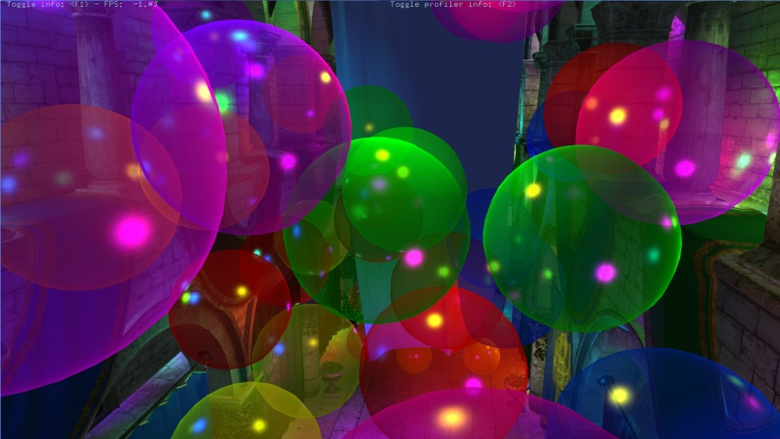
Clustered Forward – Performance
Crytek Sponza
+ Transparent Bubbles
1k Lights
CSAA
2.2x Overdraw
Notes:
Now lets look at some runtime frame rates, measured on a GTX 580 gpu

Slide 59
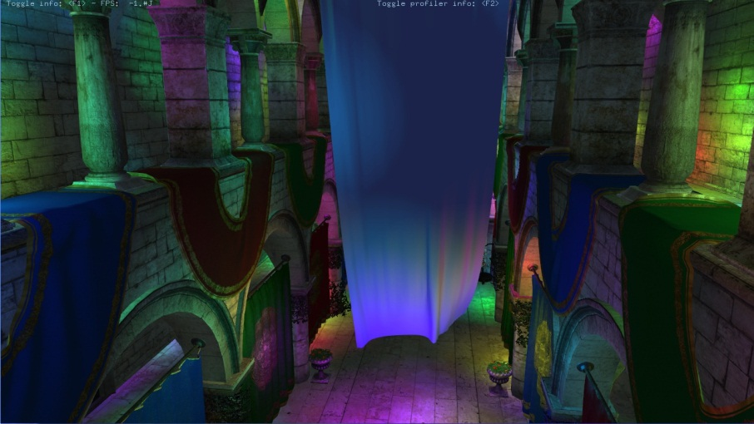
Clustered Forward – Performance
Tiled Deferred
Edge Detection
Single sample shading
No Overdraw
Deferred = Single layer
Notes:
First let me point out that the measures for deferred does not include the transparent geometry.
So it is not a completely fair comparison.
Also, the implementation only shades all samples at discontinuities, As proposed by Lauritzen 2010. Therefore, most of the pixels in this view are computing the shading for just a single sample.

Slide 60
Clustered Forward – Performance
1024 lights
CSAA
Clustered
125 to 142 FPS
Tiled
66 to 217 FPS
Notes:
So forward shades 2.2 times more samples for this view.
Despite this we see that Clustered Forward outperforms Tiled Deferred at high MSAA levels.
The dashed red line shows tiled deferred scaled to account for the difference in samples shaded.
In this case we see that clustered shading is far more efficient.
Also worth noting is that scaling with increasing MSAA levels is much better for the forward shading techniques.

Slide 61
Clustered Shading - Summary
High performance
Low view dependence
Good worst-case performance
Fully Dynamic
Supports transparency
Forward / Deferred, or both
Practical?
Let’s ask Emil

Slide 62
References
[1] Multi-Image Based Photon Tracing for Interactive Global Illumination of Dynamic Scenes, Yao et. al. 2010
[2] Deferred shading techniques using frostbite in "Battlefield 3" and "Need for Speed the Run“, Ferrier and Coffin. 2011
[3] Clustered Deferred and Forward Shading, Olsson et.al. 2012
[4] Tiled and Clustered Forward Shading, Olsson et.al. 2012
Demo implementation with source: http://www.cse.chalmers.se/~olaolss

Slide 63
The Cluster Advantage
Fast voxelization of samples
Shadows?!
Starting points for cone tracing?
Approximate shading?
Adaptive shading?
Other uses?

